Slide 1
Lecture 06
Decision Tree Learning
Rabiya Tahir
Sr. Lecturer

Slide 2
Classification Techniques
Decision Tree based Methods
Rule-based Methods
Naïve Bayes and Bayesian Belief Networks
Neural Networks
Support Vector Machines
and more...

Slide 3
Learning decision trees
Example Problem: decide whether to wait for a table at a restaurant, based on the following attributes:
  Alternate: is there an alternative restaurant nearby?
  Waiting area: is there a comfortable area to wait in?
  Fri/Sat: is today Friday or Saturday?
  Hungry: are we hungry?
  Patrons: number of people in the restaurant (None, Some, Full)
  Price: price range ($, $$, $$$)
  Raining: is it raining outside?
  Reservation: have we made a reservation?
  Type: kind of restaurant (French, Italian, Thai, Burger)
  Wait Estimate: estimated waiting time (0-10, 10-30, 30-60, >60)

Slide 4
Decision Tree Construction Algorithm
Principle
  Basic algorithm (adopted by ID3, C4.5 and CART): a greedy algorithm
  Tree is constructed in a top-down recursive divide-and-conquer manner
Iterations
  At start, all the training tuples are at the root
  Tuples are partitioned recursively based on selected attributes
  Test attributes are selected on the basis of a heuristic or statistical measure (e.g, information gain)
Stopping conditions
  All samples for a given node belong to the same class
  There are no remaining attributes for further partitioning – majority voting is employed for classifying the leaf
  There are no samples left

Slide 5
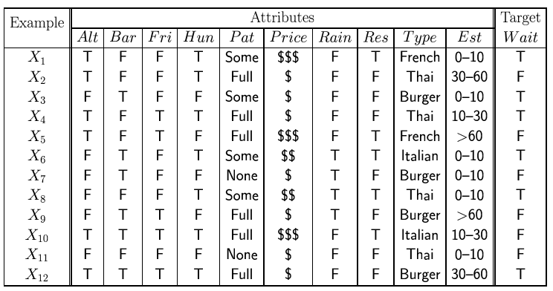
Feature(Attribute)-based representations
Examples described by feature(attribute) values
  (Boolean, discrete, continuous)
E.g., situations where I will/won't wait for a table:
Classification of examples is positive (T) or negative (F)

Slide 6
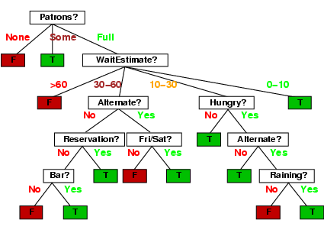
Decision trees
One possible representation for hypotheses
E.g., here is the “true” tree for deciding whether to wait:

Slide 7
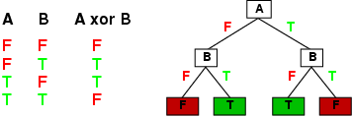
Expressiveness
Decision trees can express any function of the input attributes.
E.g., for Boolean functions, truth table row → path to leaf:
Trivially, there is a consistent decision tree for any training set with one path to leaf for each example (unless f nondeterministic in x) but it probably won't generalize to new examples
Prefer to find more compact decision trees

Slide 8
CART – Classification And Regression Tree
An implementation of Decision Trees, among others such as ID3, C4.5.
The non-terminal nodes are the root node and the internal node.
The terminal nodes are the leaf nodes.
Each non-terminal node represents a single input variable (x) and a splitting point on that variable; the leaf nodes represent the output variable (y).
The model is used as follows to make predictions: walk the splits of the tree to arrive at a leaf node and output the value present at the leaf node.

Slide 9
CART
CART is an alternative decision tree building algorithm.
It can handle both classification and regression tasks.
This algorithm uses a new metric named gini index to create decision points for classification tasks.

Slide 10
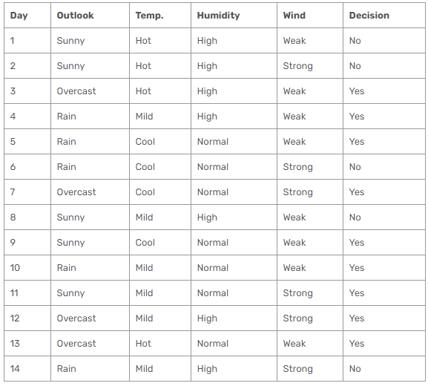
There are 14 instances of golf playing decisions based on outlook, temperature, humidity and wind factors.
Gini index
Gini index is a metric for classification tasks in CART. It stores sum of squared probabilities of each class. We can formulate it as illustrated below.
Gini = 1 – Σ (Pi)² for i=1 to number of classes

Slide 11
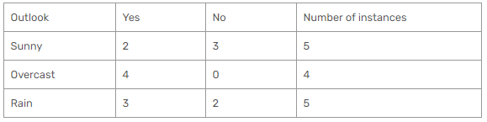
Outlook
Outlook is a nominal feature. It can be sunny, overcast or rain. I will summarize the final decisions for outlook feature.
Gini(Outlook=Sunny) = 1 – (2/5)² – (3/5)² = 1 – 0.16 – 0.36 = 0.48
Gini(Outlook=Overcast) = 1 – (4/4)² – (0/4)² = 0
Gini(Outlook=Rain) = 1 – (3/5)² – (2/5)² = 1 – 0.36 – 0.16 = 0.48
Then, we will calculate weighted sum of gini indexes for outlook feature.
Gini(Outlook) = (5/14) x 0.48 + (4/14) x 0 + (5/14) x 0.48 = 0.171 + 0 + 0.171 = 0.342

Slide 12
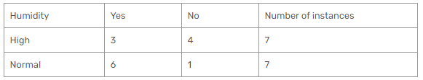
Humidity
Humidity is a binary class feature. It can be high or normal.
Gini(Humidity=High) = 1 – (3/7)² – (4/7)² = 1 – 0.183 – 0.326 = 0.489
Gini(Humidity=Normal) = 1 – (6/7)² – (1/7)² = 1 – 0.734 – 0.02 = 0.244
Weighted sum for humidity feature will be calculated next
Gini(Humidity) = (7/14) x 0.489 + (7/14) x 0.244 = 0.367

Slide 13
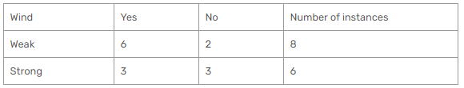
Wind
Wind is a binary class similar to humidity. It can be weak and strong.
Gini(Wind=Weak) = 1 – (6/8)² – (2/8)² = 1 – 0.5625 – 0.062 = 0.375
Gini(Wind=Strong) = 1 – (3/6)² – (3/6)² = 1 – 0.25 – 0.25 = 0.5
Gini(Wind) = (8/14) x 0.375 + (6/14) x 0.5 = 0.428

Slide 14
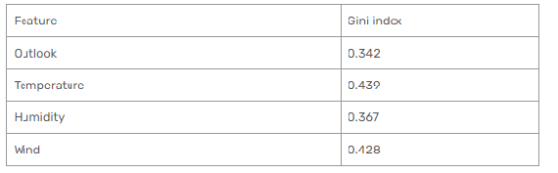
Time to decide
We’ve calculated gini index values for each feature. The winner will be outlook feature because its cost is the lowest.
We’ll put outlook decision at the top of the tree.

Slide 15
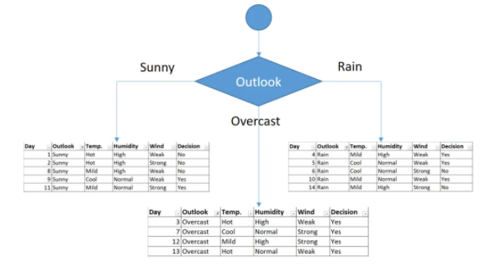
First Decision would be outlook
You might realize that sub dataset in the overcast leaf has only yes decisions. This means that overcast leaf is over

Slide 16
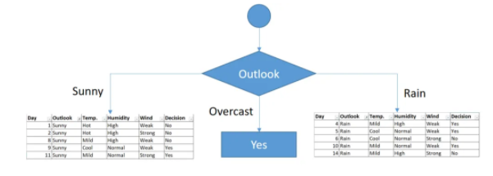
Tree is over for overcast outlook leaf

Slide 17
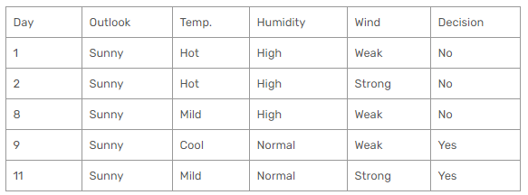
Outlook (Sunny)
We will apply same principles to those sub datasets in the following steps.
Focus on the sub dataset for sunny outlook. We need to find the gini index scores for temperature, humidity and wind features respectively.

Slide 18
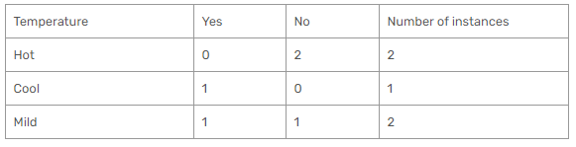
Gini of temperature for sunny outlook
Gini(Outlook=Sunny and Temp.=Hot) = 1 – (0/2)² – (2/2)² = 0
Gini(Outlook=Sunny and Temp.=Cool) = 1 – (1/1)² – (0/1)² = 0
Gini(Outlook=Sunny and Temp.=Mild) = 1 – (1/2)² – (1/2)² = 1 – 0.25 – 0.25 = 0.5
Gini(Outlook=Sunny and Temp.) = (2/5)x0 + (1/5)x0 + (2/5)x0.5 = 0.2

Slide 19
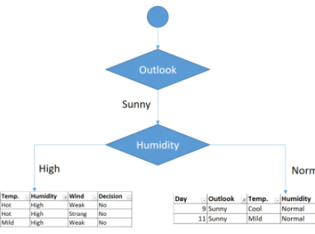
Decision for sunny outlook
In the same way calculate it for humidity and wind.
We’ve calculated gini index scores for feature when outlook is sunny. The winner is humidity because it has the lowest value.
We’ll put humidity check at the extension of sunny outlook.

Slide 20
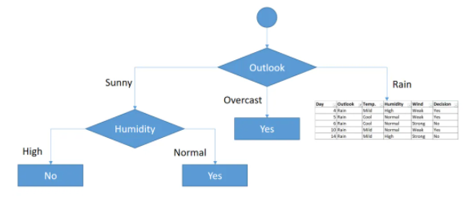
Decision for High and Normal Humidity
As seen, decision is always no for high humidity and sunny outlook. On the other hand, decision will always be yes for normal humidity and sunny outlook. This branch is over.

Slide 21
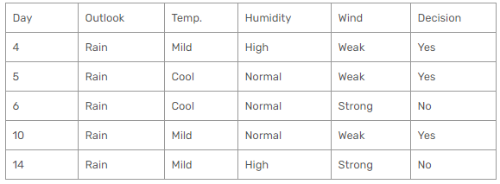
Rain outlook
We’ll calculate gini index scores for temperature, humidity and wind features when outlook is rain.

Slide 22
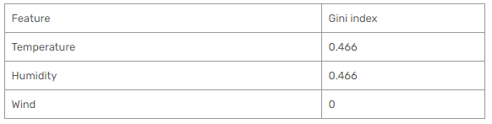
Decision for rain outlook
The winner is wind feature for rain outlook because it has the minimum gini index score in features.
Put the wind feature for rain outlook branch and monitor the new sub data sets.

Slide 23
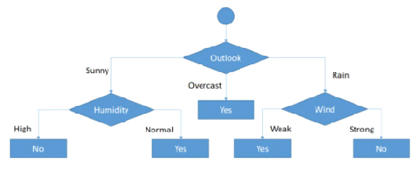
Final form of the decision tree built by CART algorithm
As seen, decision is always yes when wind is weak. On the other hand, decision is always no if wind is strong. This means that this branch is over.

Slide 24
Decision Tree Based Classification
Advantages:
  Easy to construct/implement
  Extremely fast at classifying unknown records
  Models are easy to interpret for small-sized trees
  Accuracy is comparable to other classification techniques for many simple data sets
  Tree models make no assumptions about the distribution of the underlying data : nonparametric
  Have a built-in feature selection method that makes them immune to the presence of useless variables

Slide 25
Decision Tree Based Classification
Disadvantages
  Computationally expensive to train
  Some decision trees can be overly complex that do not generalise the data well.
  Less expressivity: There may be concepts that are hard to learn with limited decision trees

Slide 26
Overfitting and Tree Pruning
Overfitting: An induced tree may overfit the training data
  Too many branches, some may reflect anomalies due to noise or outliers
  Poor accuracy for unseen samples
Two approaches to avoid overfitting
  Prepruning: Halt tree construction early—do not split a node if this would result in the goodness measure falling below a threshold
    Difficult to choose an appropriate threshold
  Postpruning: Remove branches from a “fully grown” tree—get a sequence of progressively pruned trees
    Use a set of data different from the training data to decide which is the “best pruned tree”
Data Mining: Concepts and Techniques

